Slide 1
RETAIL SALES DATASET ANALYSIS –
ADVANCED EXCEL PROJECT
SHAMINI P
DATA ANALYTICS
SEP OCT BATCH

Slide 2
INTRODUCTION:
OVERVIEW:
To analyse sales data to identify trends, understand sales performance and provide future actionable insights, capturing essential attributes that drive retail operations and customer interaction.
OBJECTIVE:
To understand the highest sales.
To create simple visualization of sales performance.
To predictions about future sales.
To analyse retail sales data and identify basic trends over time.

Slide 3
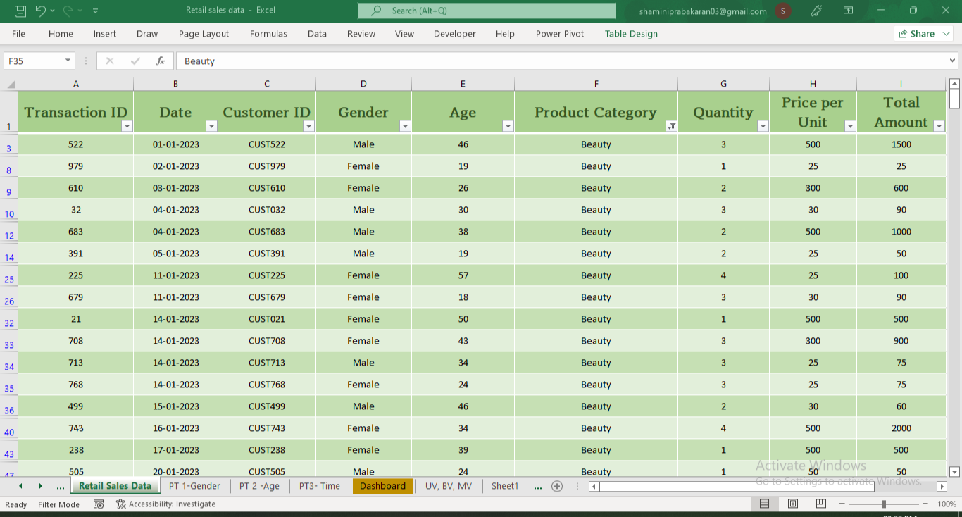
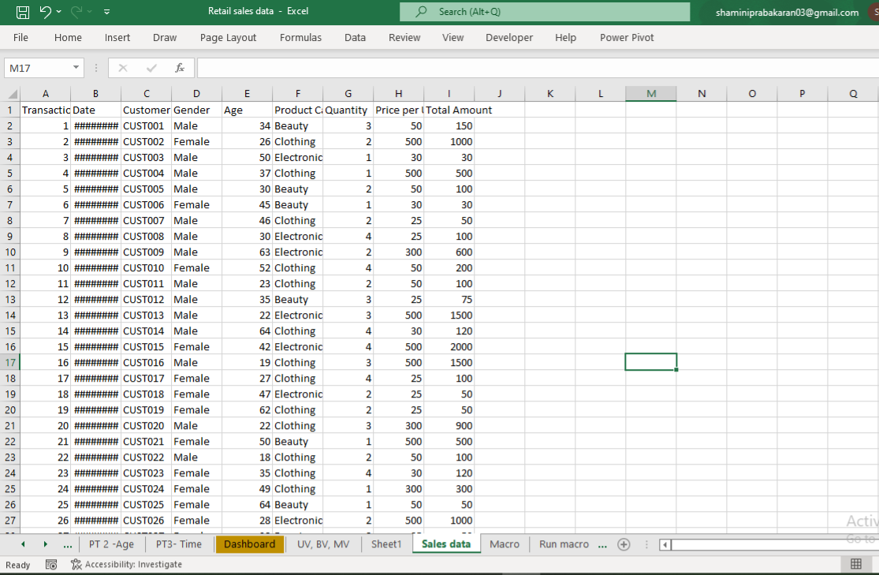

DATASET OVERVIEW :
Dataset Overview : 1001 rows, 9 columns (Transaction ID, Date, Customer ID, Gender, etc..)
Data cleaning:
. Removes duplicates (none found)
. Adjusted columns and rows
. Freeze Pane
. Calculated total sales amount
Raw Data
Clean Data

Slide 4
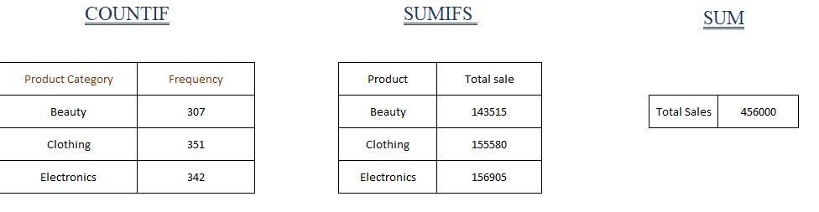
CALCULATION OF DERIVED METRICS :
Total sales amount and gross sale
Countif
Sum of total sales of each product
Total
sales

Slide 5
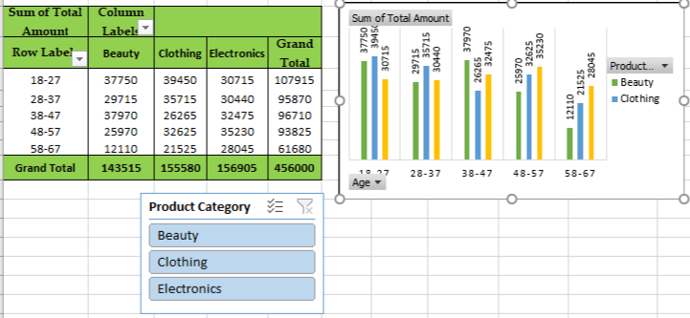
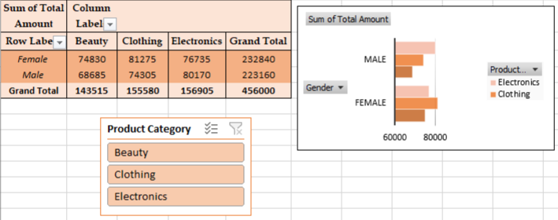
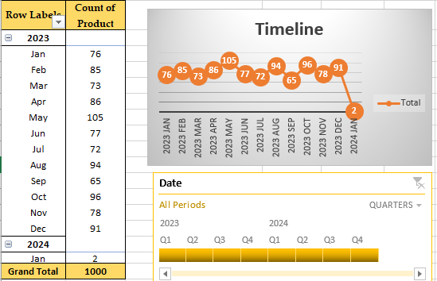
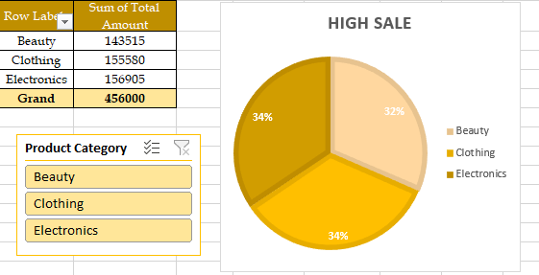
PIVOT TABLE AND PIVOT CHARTS :
Pivot Tables: Categorized by gender, age and Order date.
Pivot Charts:
Clustered bar: Sales by gender
Clustered Column: sales by age
Line with markers: Timeline
Pie chart: High sale
Age
Category
Timeline
Gender
Category
High Sale

Slide 6
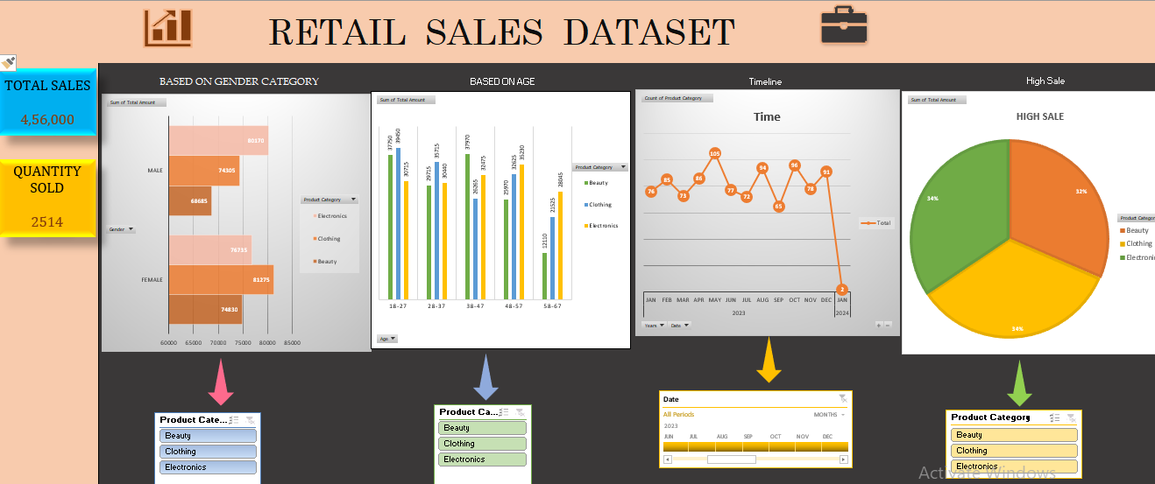
DASHBOARD OVERVIEW:
Dashboard Purpose:
Dashboard purpose: Visually summarize key performance and support data-driven decision-making.
Key performance:
Total value of sales
Total quantity sold
Highest sale
Trends:
Pivot table & Pivot charts categorized
by gender, age, highest sale and
Order date.
Slicer for product category, date

Slide 7
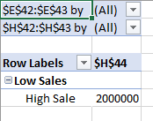
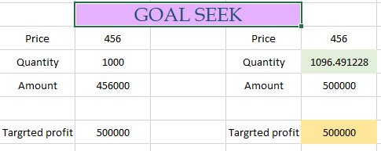
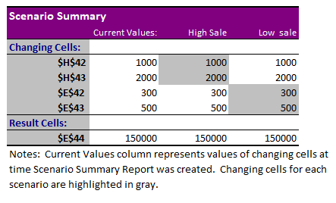
What-if analysis & Goal Seek
What-if scenario:
By changing price & quantity found the high sale and low sale.
Goal Seek
To get 5,00,000 profit want to achieve quantity 1096.49

Slide 8

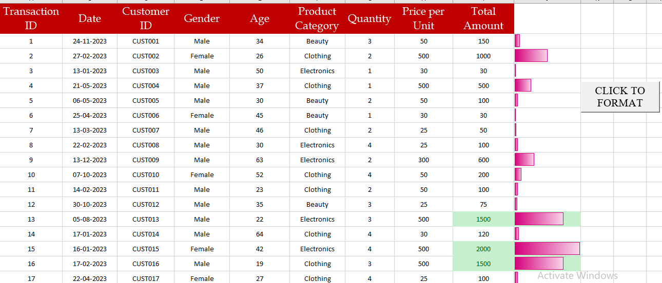
MACRO & AUTOMATION
Macro used:
Format sheets
Benefits:
Saves time, ensures consistency

Slide 9
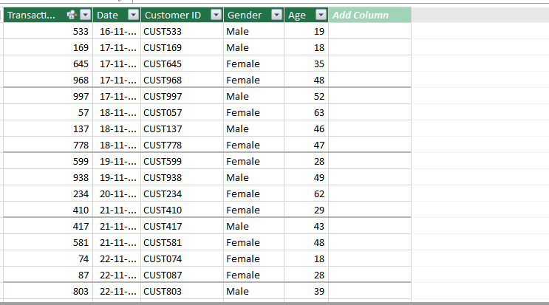
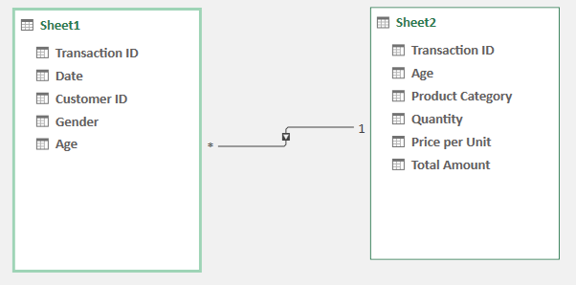
POWER PIVOT:
RELATIONSHIP DENERATED:
Generated two tables like product table and customer table.
Generated relationship between two tables.
Generated power pivot and pivot.

Slide 10
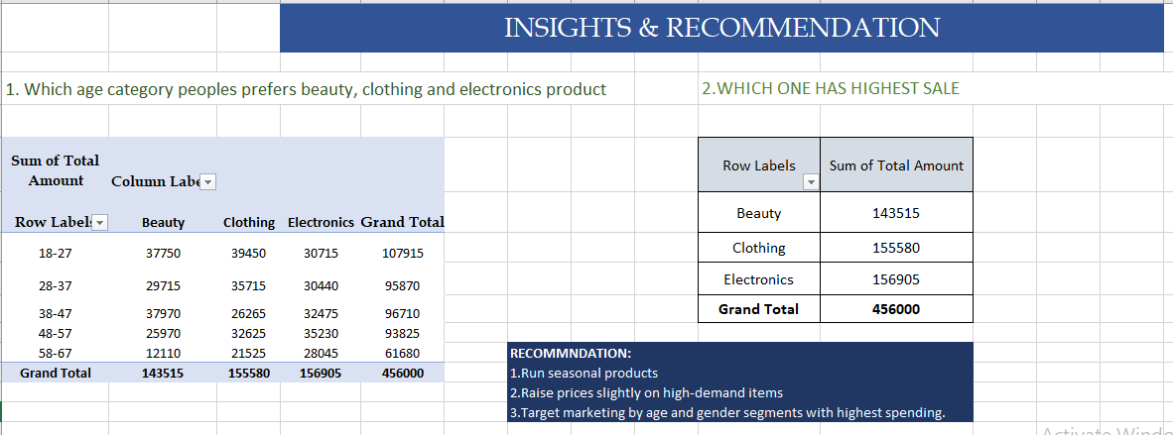
INSIGHTS & RECOMMENDATION:
Recommendations:
Run seasonal products
Raise prices slightly on high-demand items
Target marketing by age and gender segments with highest spending.
Key Insights:
Low sales in beauty products
Sales peaked in holidays

Slide 11
CONCLUSION:
SUMMARY:
Retail sales dataset analysed with excel tools
Actionable insights:
Impact on price
Need to increase quality and establish more products
Make promotions and adds

Slide 12
THANK YOU

